Slide 1
Photomicrographs of Plant foods
Apple
Permission to reproduce original photomicrographs used to make this collection may be obtained from
Dr. David O. Norris at
david.norris@colorado.edu

Slide 2
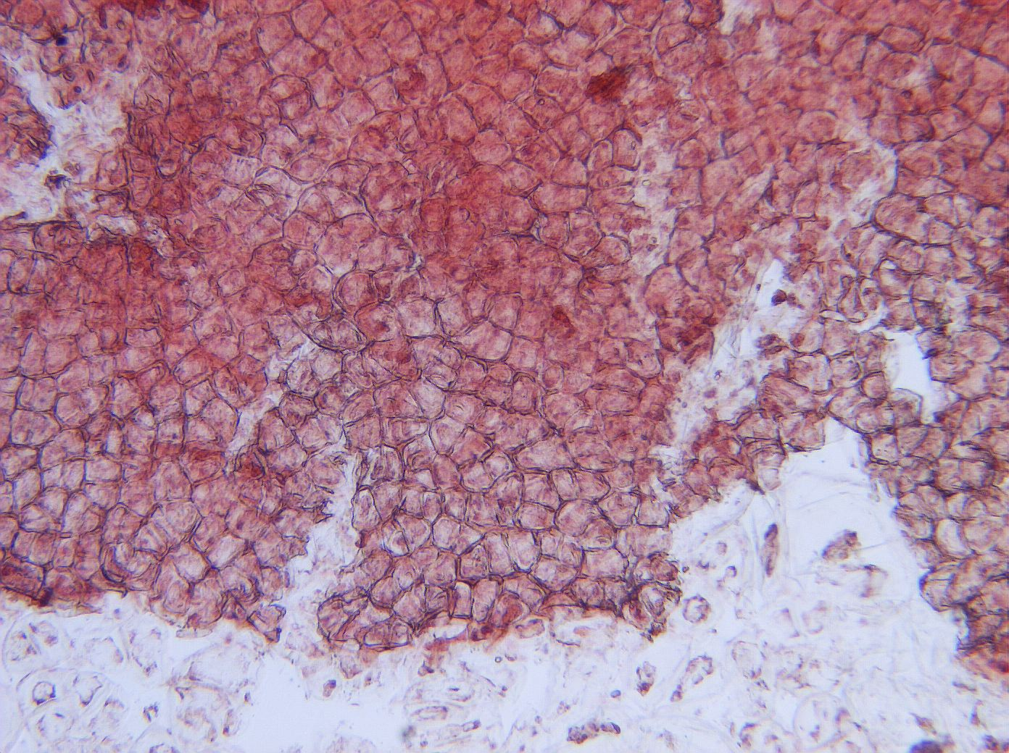
Notes:
1. Malus spp. Apple. Skin of fruit, 10X.

Slide 3
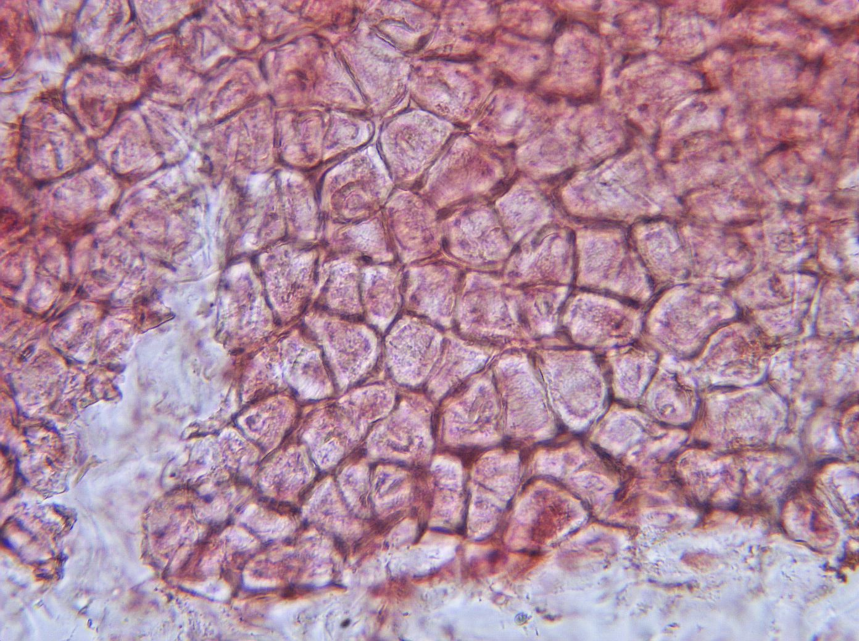
Notes:
2. Apple. Skin of fruit, 25X.

Slide 4
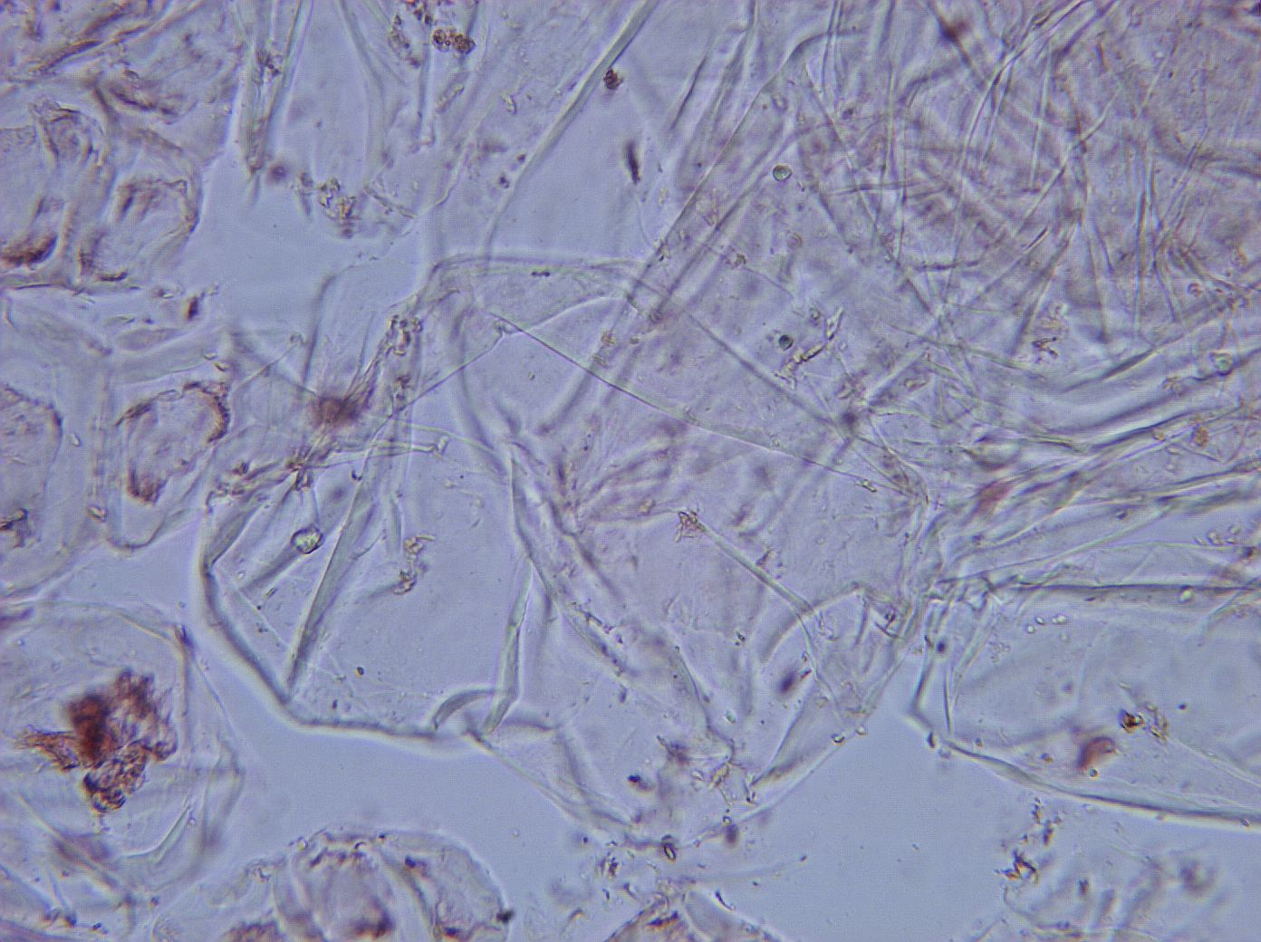
Notes:
3. Apple. Pulp cells of fruit (thin-walled parenchyma), 25X.

Slide 5
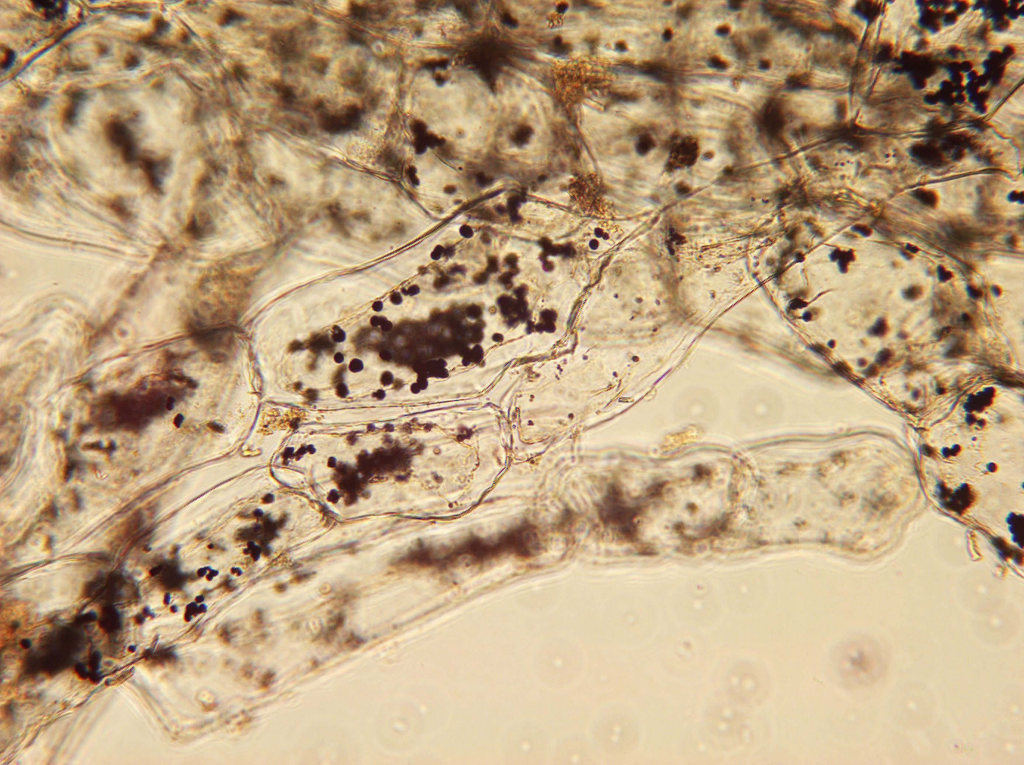
Notes:
4. Apple. Pulp cells of fruit stained for starch. Sample isolated from bear stomach, 10X. Starch grains (arrows).

Slide 6
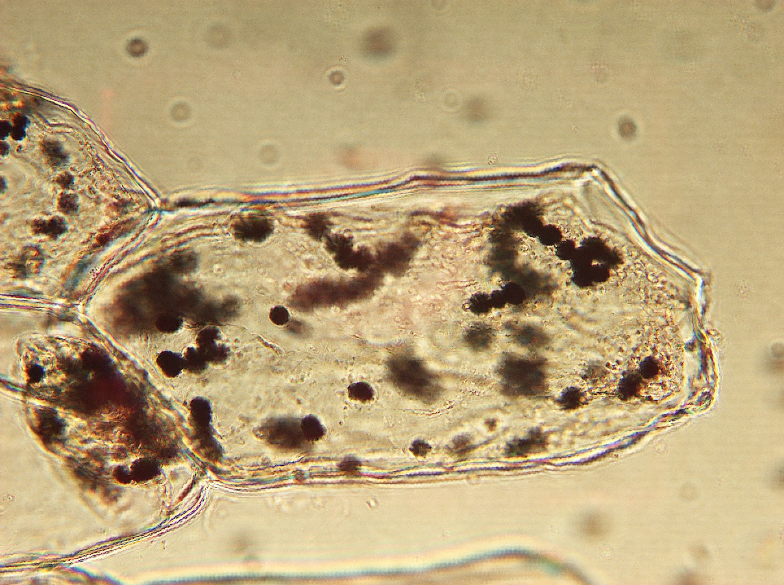
Notes:
5. Apple. Pulp cell of fruit stained for starch (arrows), isolated from bear stomach, 25X.

